Slide 1
PLUS Toolkit: Acquisition, Processing, Calibration
Matthew Holden, Kyle Sunderland
(72mh@queensu.ca, 1krs1@queensu.ca)
May 1, 2018
Laboratory for Percutaneous Surgery
Queen’s University

Slide 2
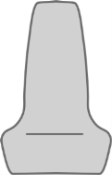
Introduction
PLUS – Public software Library for UltraSound imaging
Goal: Facilitate rapid prototyping of ultrasound-guided intervention systems for translational clinical research
Acquire, process, transfer synchronized image and position data
Ultrasound
computer
Tracker
Reference
Needle
Probe
3D Slicer
computer
Image
Phantom model

Slide 3
Introduction
My Algorithm
My Interface
My Tracker
My Algorithm v2
My Interface v2
My New Tracker
My Algorithm
PLUS
My Tracker
My New Tracker

Slide 4
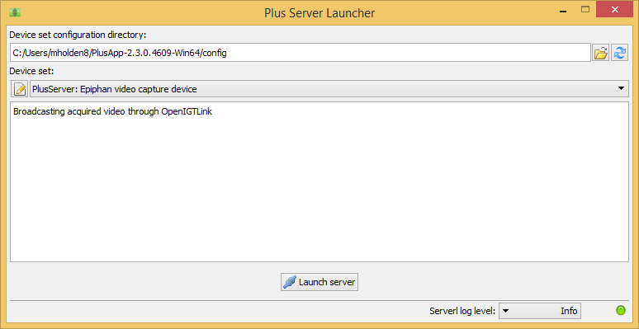
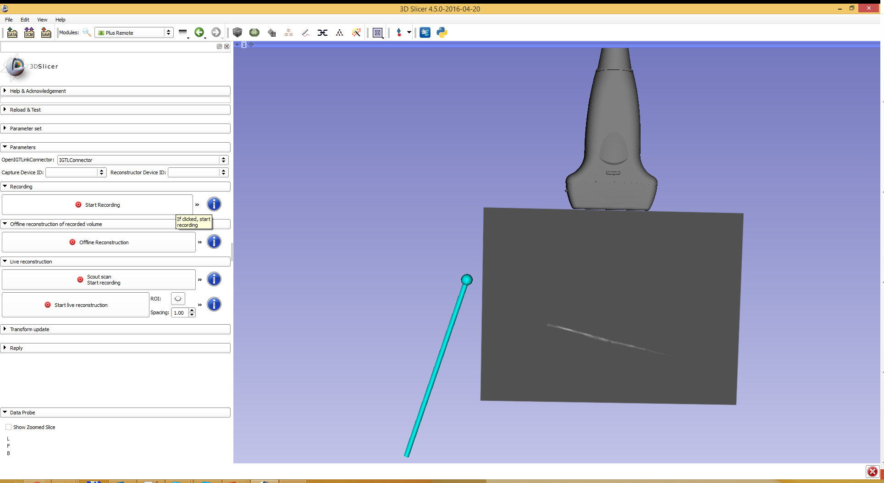
Plus Server Application
Broadcast data via OpenIGTLink (e.g. to 3D Slicer)
Remote control access from Slicer
Control data recording
Volume reconstruction

Slide 5
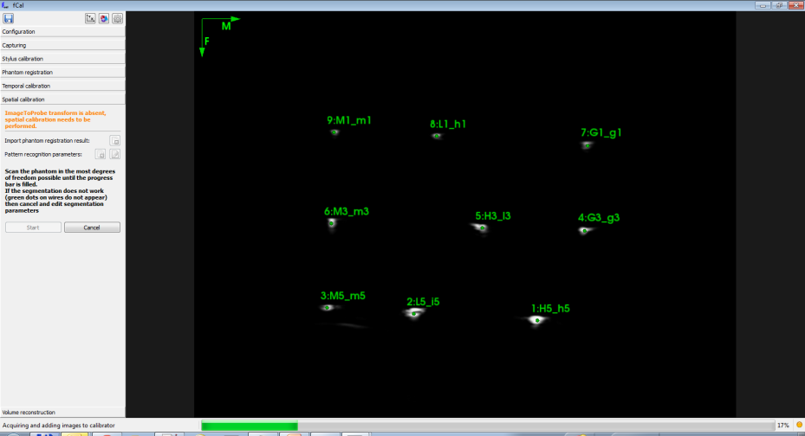
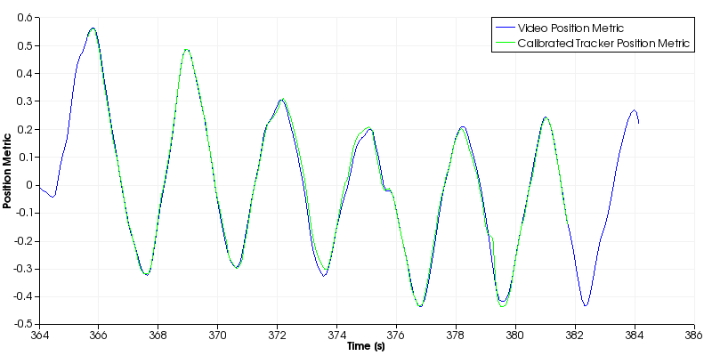
fCal Application
Spatial ultrasound calibration
Temporal ultrasound calibration

Slide 6
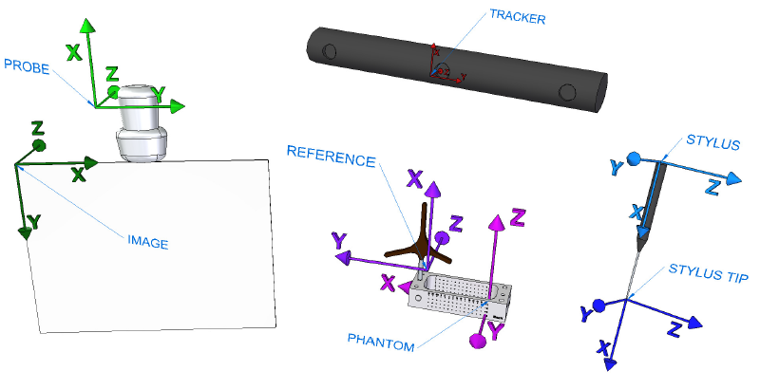
Spatial Calibration
Goal: determine the PROBE to IMAGE transform

Slide 7
Plus Server Application
PLUS
Ultrasound
computer
Tracker
Slicer
Needle
Probe
Reference
3D Slicer
computer
Image
Phantom model

Slide 8
System Overview
Hardware (ultrasound, tracker, etc.)
PLUS
SlicerRT
Slicer
…
PerkTutor
SlicerIGT (Calibration, Visualization)
Image Overlay
…

Slide 9
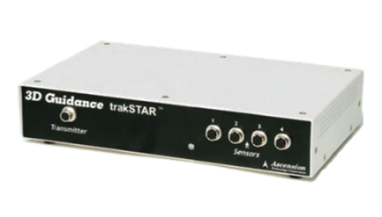
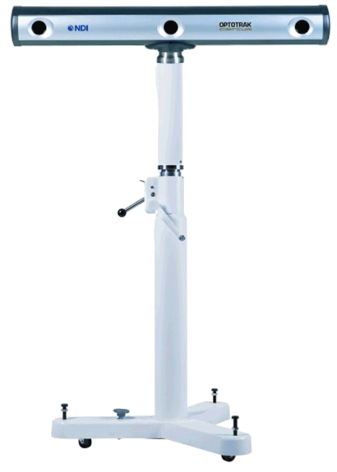
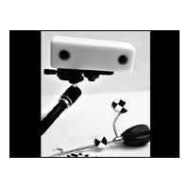
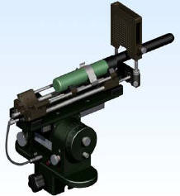
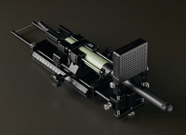
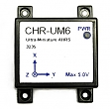
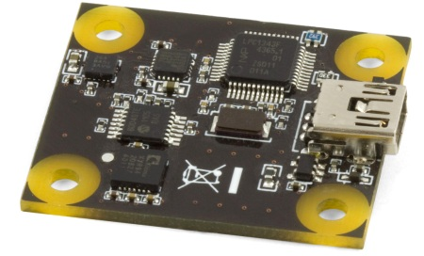
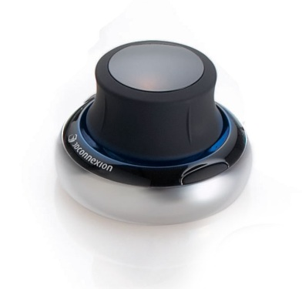
Data Acquisition - Tracking
Ascension EM tracker
NDI Aurora, Polaris, and Certus optical and electromagnetic trackers
Claron MicronTracker optical tracker
Brachy steppers (CMS Accuseed, Burdette Medical systems, CIVCO)
PhidgetSpatial inertial measurement device
CHRobotics inertial measurement device
3dConnexion SpaceNavigator 3D mouse
OpenIGTLink (for BrainLab, Siemens MRI scanners, and other compatible devices)
Software devices: file source, US simulator

Slide 10
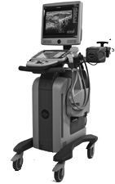
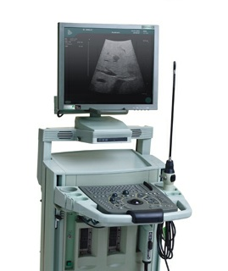
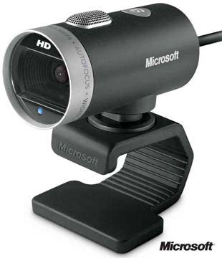
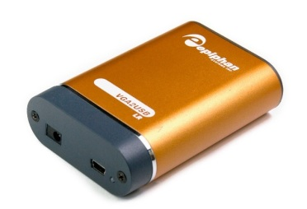
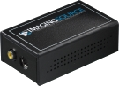
Data Acquisition - Imaging
Ultrasonix: B-mode & RF (through research interface)
BK ProFocus: B-mode & RF (through research interface)
ImagingControl framegrabbers
Epiphan framegrabbers
Video for Windows devices
OpenIGTLink (for MUSiiC, Siemens MRI scanners, and other compatible devices)
Other software devices: file source, US simulator

Slide 11
Sequence Files
Based on the Meta IO standard image file format (.mha, .mhd)
Images readable by many existing applications (e.g. 3D Slicer)
Extra information for tracking/reconstruction
Image orientation
Transforms from tracker
Tracker and image status
Timestamps
etc.
Used by all applications of Plus

Slide 12
Sequence Files
ObjectType = Image
NDims = 3
BinaryData = True
BinaryDataByteOrderMSB = False
CompressedData = True
DimSize = 820 616 97
ElementType = MET_UCHAR
…
UltrasoundImageOrientation = MF
Seq_Frame0000_ProbeToTrackerTransform = 0.956683 -0.263308 0.124204 -190.886 0.269031 0.962616 -0.0315089 -98.0911 -0.111264 0.0635588 0.991756 -1949.07 0 0 0 1
Seq_Frame0000_ProbeToTrackerTransformStatus = OK
Seq_Frame0000_ReferenceToTrackerTransform = 0.260287 0.964665 0.0408926 -208.632 -0.96117 0.262899 -0.0838866 -115.511 -0.0916731 -0.0174702 0.995636 -1992.7 0 0 0 1
Seq_Frame0000_ReferenceToTrackerTransformStatus = OK
Seq_Frame0000_StylusToTrackerTransform = 1 -8.43482e-005 0.000190641 0.370779 8.39344e-005 1 0.000146179 0.316166 -0.00019069 -0.000146138 1 -0.0640528 0 0 0 1
Seq_Frame0000_StylusToTrackerTransformStatus = INVALID
Seq_Frame0000_Timestamp = 345.627957
Seq_Frame0000_ImageStatus = OK
…
Seq_Frame0096_StylusToTrackerTransform = 1 0.000362791 -8.01739e-005 -0.106056 -0.000363818 1 -0.000369765 -0.839888 8.00139e-005 0.000370927 1 0.0862409 0 0 0 1
Seq_Frame0096_StylusToTrackerTransformStatus = INVALID
Seq_Frame0096_Timestamp = 355.783014
Seq_Frame0096_ImageStatus = OK
ElementDataFile = LOCAL
xœìÝw...
EditSequenceFile.exe
Editor for sequence files
ViewSeqMetaFile.exe
Replay saved sequence files

Slide 13
PLUS Configuration Files

Slide 14
Terminology
Tag: XML tag is an entry in an XML file
<Unicorn/>
Attribute: XML attribute is a property of a tag
<Unicorn realness=“notReal” size=12 />
Example:
<Animals>
<Animal species=“Unicorn” realness=“notReal” size=12 />
<Animal species=“Elephant” realness=“real” size=50 />
</Animals>

Slide 15
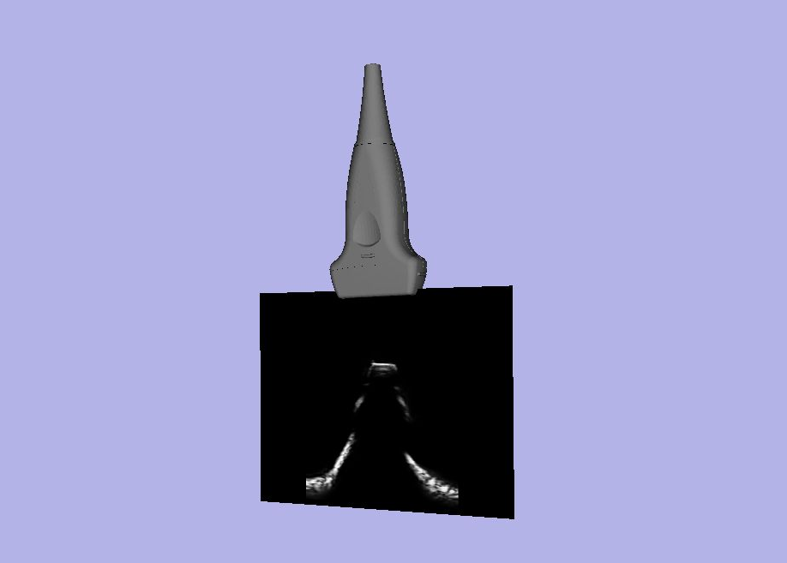
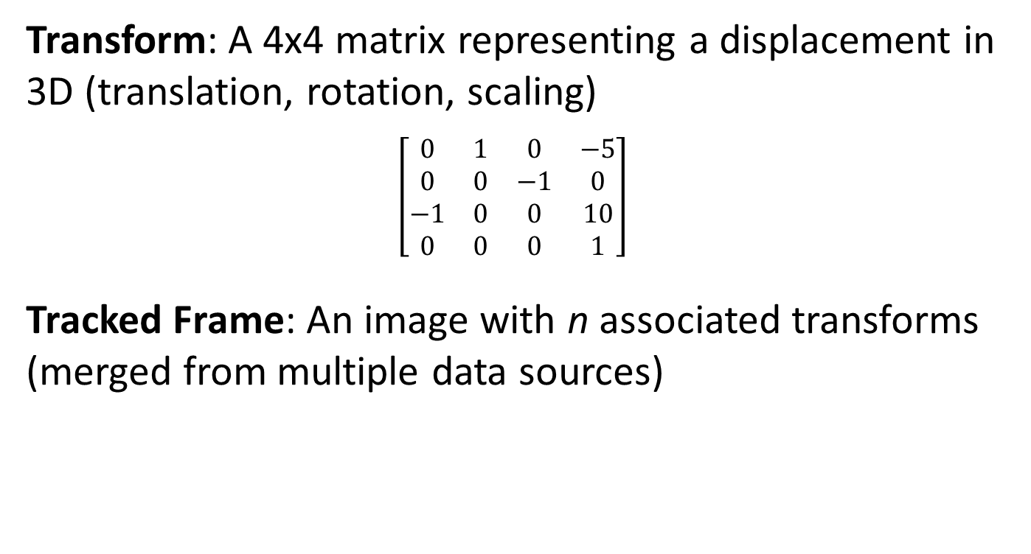
Terminology
Transform: A 4x4 matrix representing a displacement in 3D (translation, rotation, scaling)
$$\left[\begin{matrix}0 & 1 & 0 & −5 \\ 0 & 0 & −1 & 0 \\ −1 & 0 & 0 & 10 \\ 0 & 0 & 0 & 1\end{matrix}\right]$$
Tracked Frame: An image with n associated transforms (merged from multiple data sources)

Slide 16
Terminology
Hardware: Any physical or virtual device
An EM position tracker
Device: The interface to a hardware
Interface to EM position tracker
Data Source: A construct around a buffer containing meta information (e.g. what type of source)
The tracking data for the ultrasound probe
Channel: A construct representing a stream of data
The combined tracking data

Slide 17
Pipeline
EM Tracker
Tracking Channel
Virtual Capture
Virtual Mixer
Combined Channel
Image Channel
Visualization Client
Ultrasound
Data Flow
Devices are the creation point of data
Record, simulate, process “external” data
Channels are the communication point between devices
Outputs tracked frames for client consumption
Notes:
Explain what a mixer device is
Explain what a capture device is

Slide 18
Example: Tracked Video
Linking input & output via channels
Device -> channel -> device (repeat)
<Device
Id="TrackerDevice“
Type="Ascension3DG“
ToolReferenceFrame="Tracker"
... >
<DataSources>
<DataSource Type="Tool" Id="Probe" PortName="0" />
<DataSource Type="Tool" Id="Reference" PortName="1" />
<DataSource Type="Tool" Id="Stylus" PortName="2" />
</DataSources>
<OutputChannels>
<OutputChannel Id="TrackerStream" >
<DataSource Id="Probe"/>
<DataSource Id="Reference"/>
<DataSource Id="Stylus"/>
</OutputChannel>
</OutputChannels>
</Device>
<Device
Id="VideoDevice“
Type="SonixVideo“
ImageToTransducerTransformName="ImageToTransducer“
... >
<DataSources>
<DataSource
Type="Video“
Id="Video“
PortName="B“
PortUsImageOrientation="UF" />
</DataSources>
<OutputChannels>
<OutputChannel
Id="VideoStream“
VideoDataSourceId="Video“ />
</OutputChannels>
</Device>
<Device Id="TrackedVideoDevice" Type="VirtualMixer" >
<InputChannels>
<InputChannel Id="TrackerStream" />
<InputChannel Id="VideoStream" />
</InputChannels>
<OutputChannels>
<OutputChannel Id="TrackedVideoStream"/>
</OutputChannels>
</Device>
Notes:
Emphasize the linkage by ID, give them a basis to understand other config files

Slide 19
Example: Tracked Video
Internal data sources
Output Channel
Output Channel
Video
Video
Input Channel
Video
VideoDevice
Video
ProbeToTracker
Input Channel
ReferenceToTracker
Internal data sources
Output Channel
ProbeToTracker
StylusToTracker
ProbeToTracker
ProbeToTracker
ReferenceToTracker
ReferenceToTracker
ReferenceToTracker
StylusToTracker
StylusToTracker
StylusToTracker
MixerDevice
TrackerDevice

Slide 20
Configuration Files
<DataCollection> - Where the devices/channels all go
<PlusOpenIGTLinkServer> - What to send by OpenIGTLink
<CoordinateDefinitions> - Constant transforms
Notes:
Emphasize the linkage by ID, give them a basis to understand other config files

Slide 21
Configuration Files
<Rendering> - Tool display in fCal
<Segmentation> - How to segment ultrasound images in fCal
<VolumeReconstruction> - Parameters for algorithm
<fCal> - General parameters for fCal
<PhantomDefinition> - Phantom landmark and wire positions
<vtkPivotCalibrationAlgo> - Pivot calibration parameters
<vtkPhantomLandmarkRegistrationAlgo> - Phantom registration parameters
<vtkProbeCalibrationAlgo> - Image calibration parameters
Notes:
Emphasize the linkage by ID, give them a basis to understand other config files

Slide 22
Some Advice
Do NOT start from scratch

Slide 23
PLUS Configuration File Tutorial

Slide 24


Laptops/Webcams/Markers
Please take Windows laptop (if you do not have one)
Please take webcam (if you do not have one)
Please take two paper markers:

Slide 25
Download & Install PLUS
From: http://perk-software.cs.queensu.ca/plus/packages/nightly/
Choose: PlusApp-…-Win32.exe
NOT Ultrasonix/Telemed/etc.

Slide 26
PLUS Configuration File Tutorial: Webcam

Slide 27
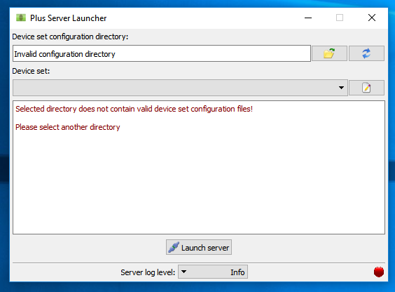
Start PLUS Server Launcher

Slide 28
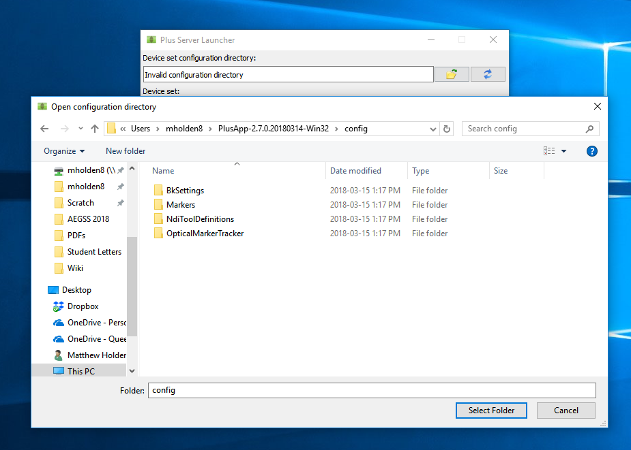
Select Configuration File Directory
1
2
Directory where you installed PLUS (C:/Users/<YourUserName>/PlusApp-…-Win32/config)
Choose “config” subdirectory
3

Slide 29
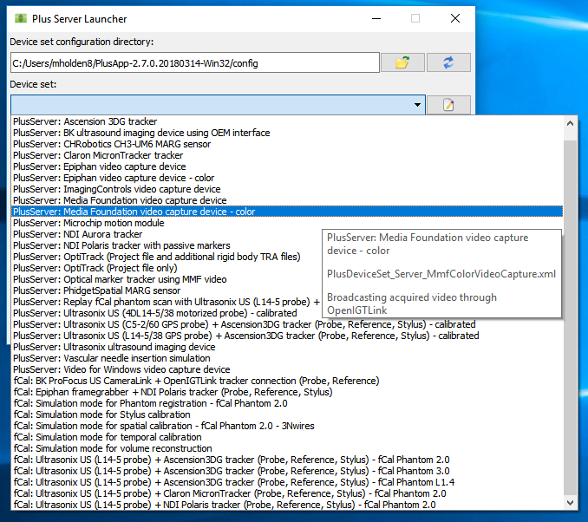
Choose Configuration for Color Video
1
2

Slide 30
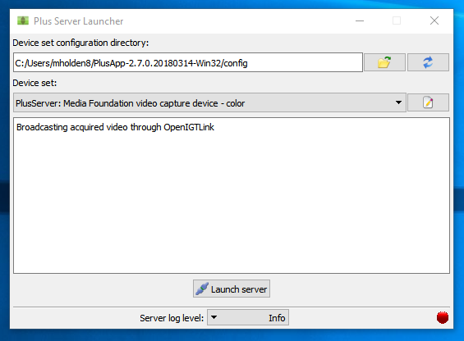
Launch Server
1
May take a few seconds…

Slide 31
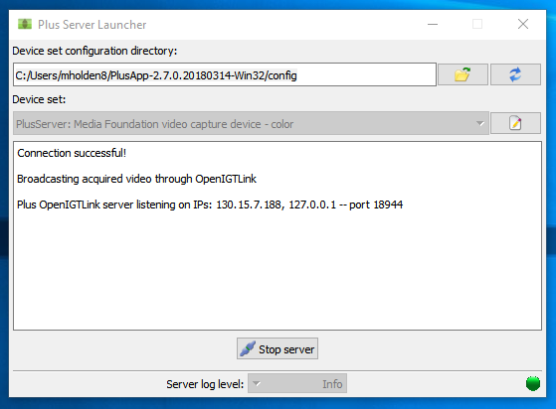
Check Connection
See

Slide 32
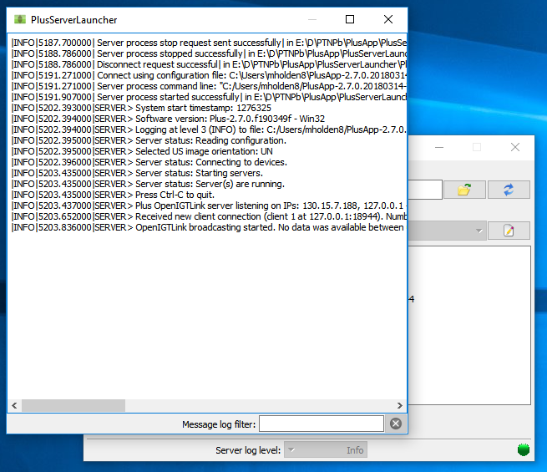
Check Message Log
1

Slide 33
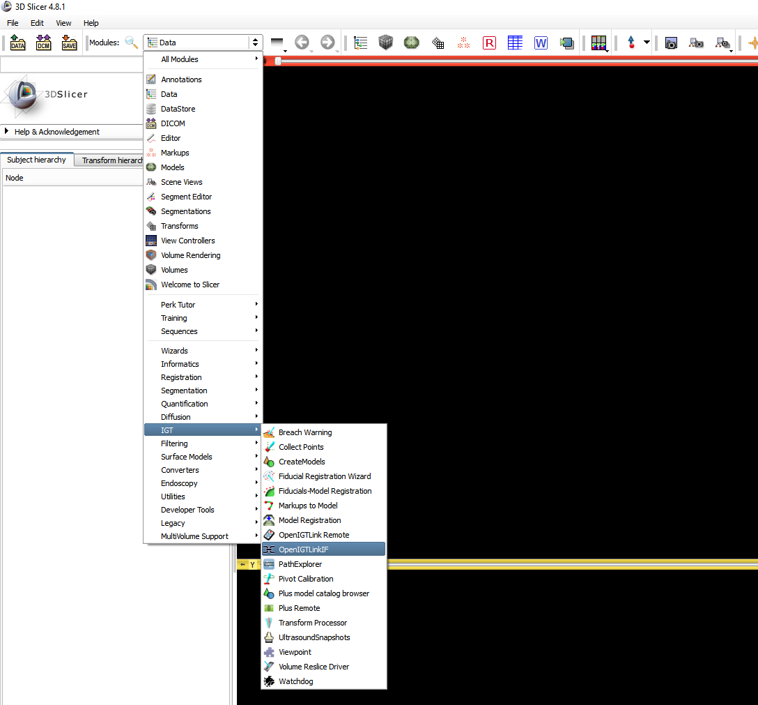
Connect from Slicer
1
2

Slide 34
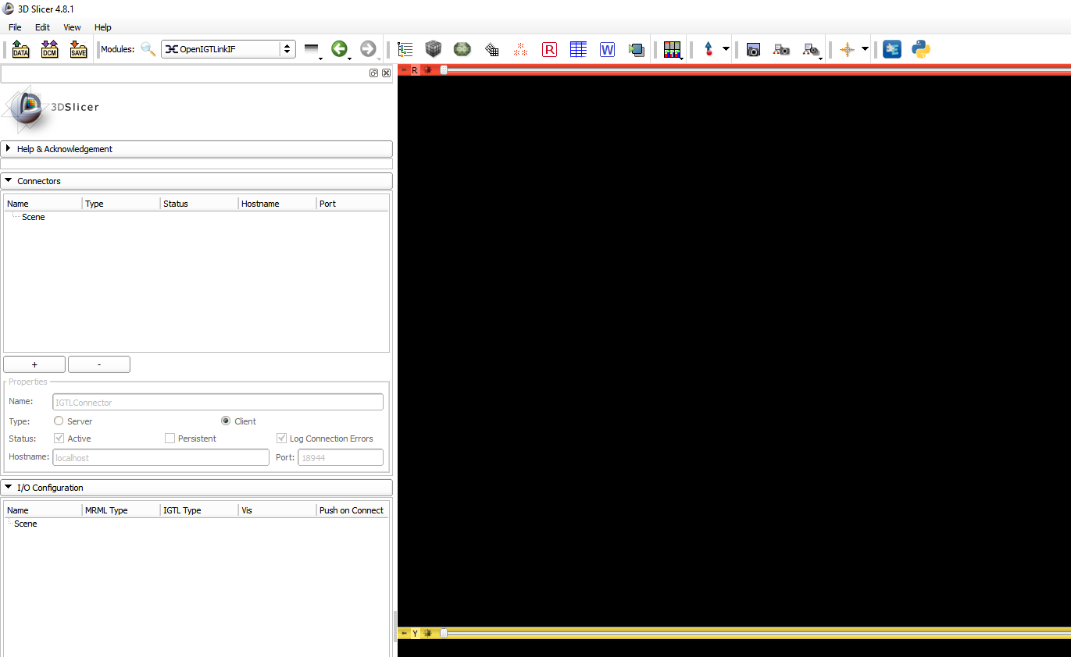
Connect from Slicer
1
2
See
Should populate with
Scene > IGTLConnector > IN > Image_Reference

Slide 35
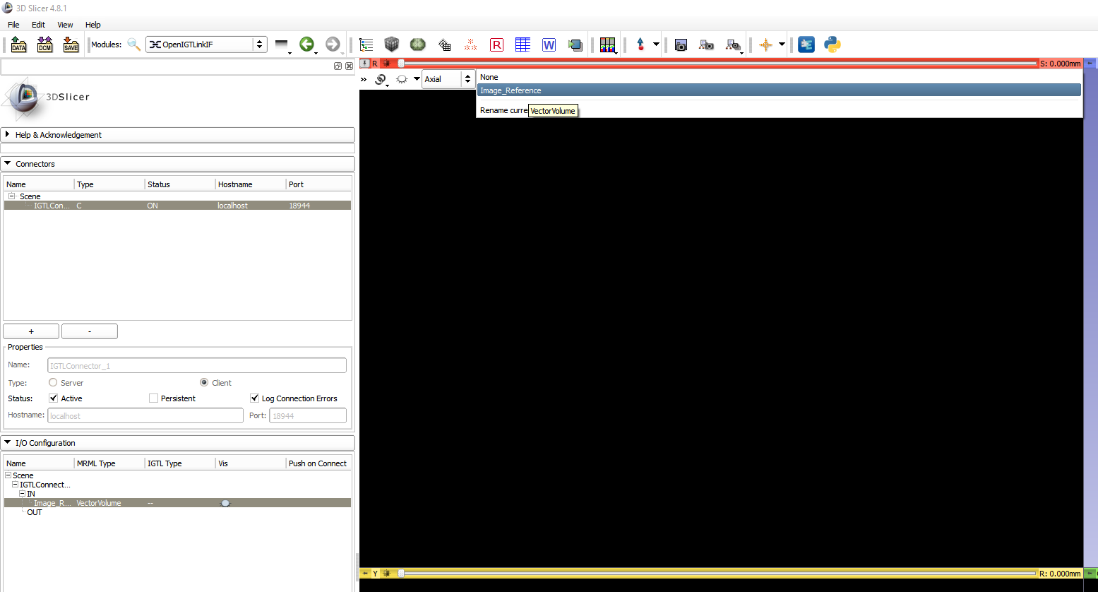
View Sent Images
1
2

Slide 36
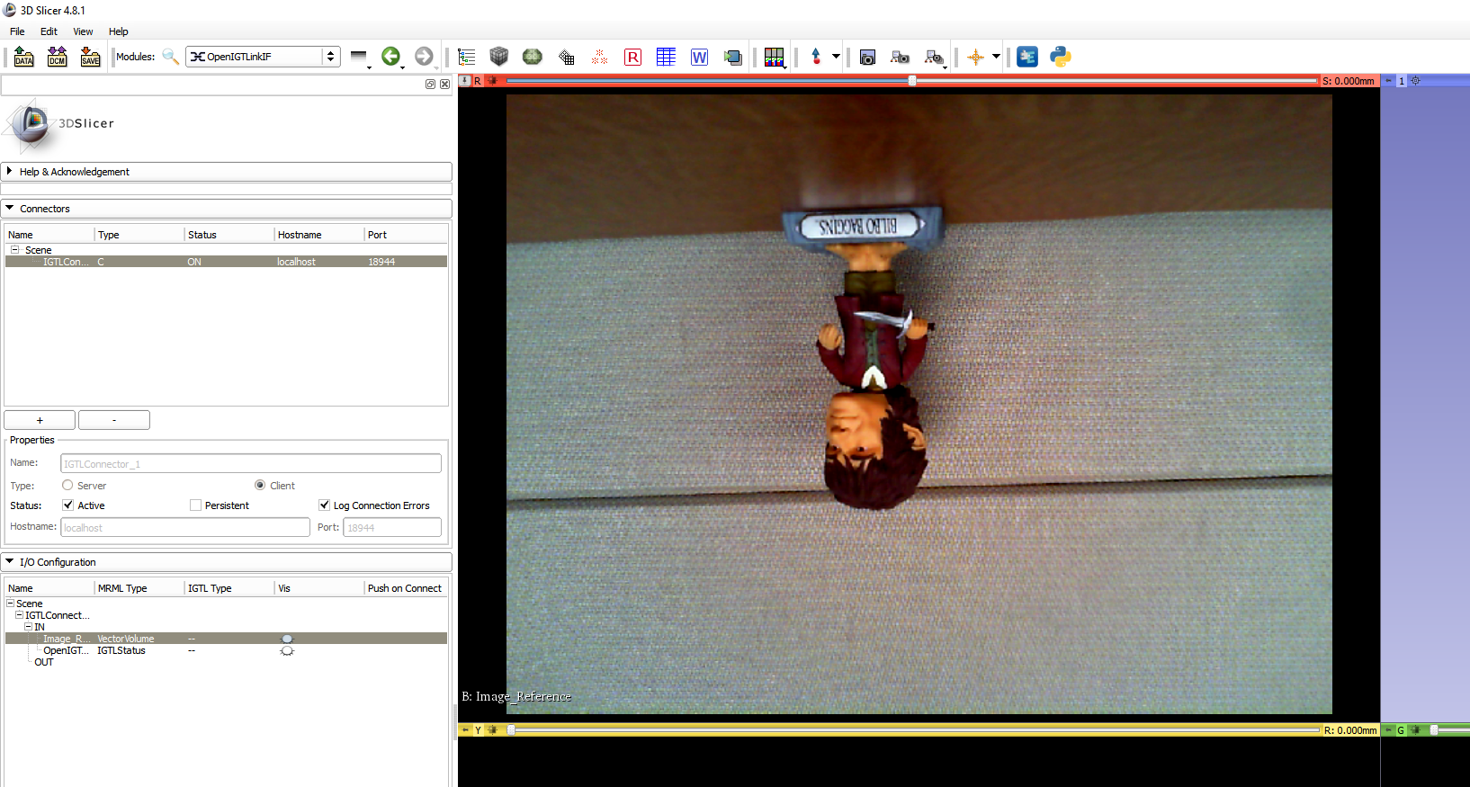
View Sent Images
1
See

Slide 37
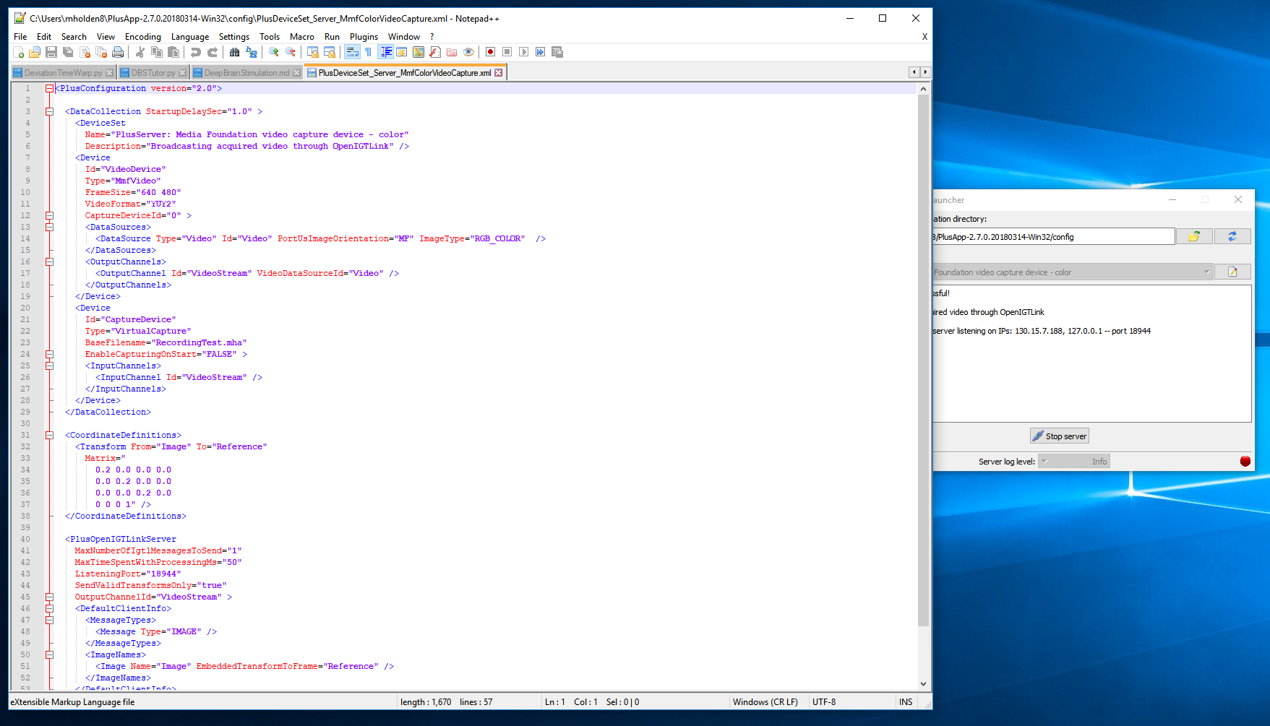
Edit Configuration Files
1
See

Slide 38
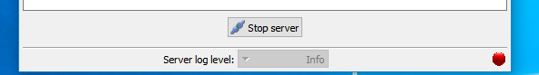
Orienting Image Properly
<Device
Id="VideoDevice"
Type="MmfVideo"
FrameSize="640 480"
VideoFormat="YUY2"
CaptureDeviceId="0" >
<DataSources>
<DataSource Type="Video" Id="Video" PortUsImageOrientation="UN" ImageType="RGB_COLOR" />
</DataSources>
<OutputChannels>
<OutputChannel Id="VideoStream" VideoDataSourceId="Video" />
</OutputChannels>
</Device>
Change to “UN”
(if this does not work, try “MN”)
1,2

Slide 39
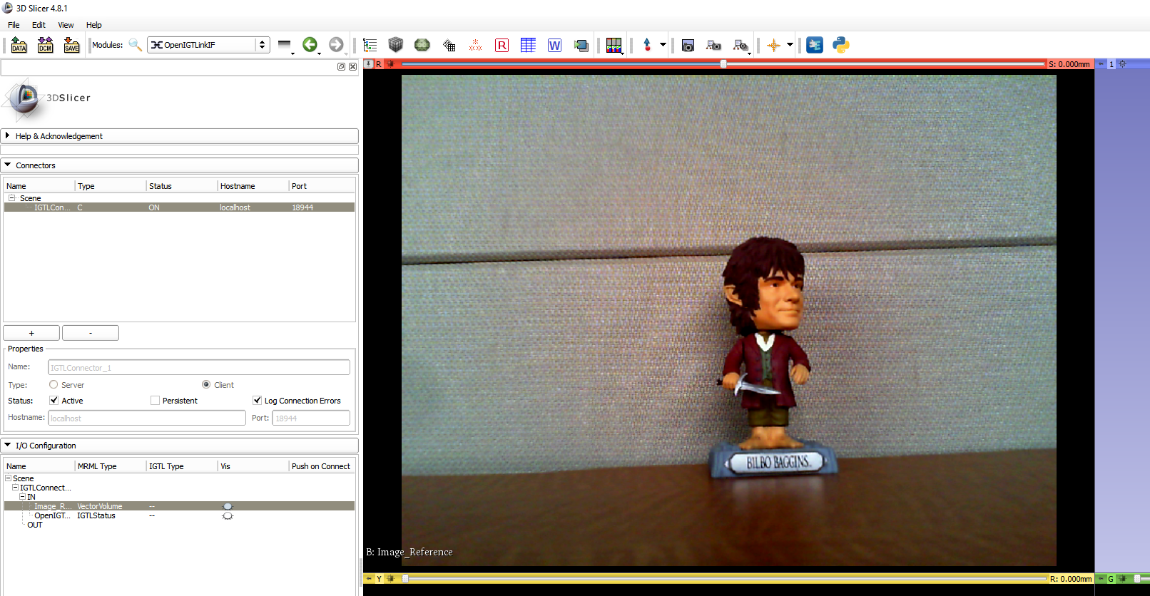
View Sent Images
See

Slide 40
Increase Image Resolution
Change to “1280 720”
Not all webcams support all resolutions (check for list of supported resolutions in PLUS message log)
<Device
Id="VideoDevice"
Type="MmfVideo"
FrameSize=“1280 720"
VideoFormat="YUY2"
CaptureDeviceId="0" >
<DataSources>
<DataSource Type="Video" Id="Video" PortUsImageOrientation="UN" ImageType="RGB_COLOR" />
</DataSources>
<OutputChannels>
<OutputChannel Id="VideoStream" VideoDataSourceId="Video" />
</OutputChannels>
</Device>
1,2

Slide 41
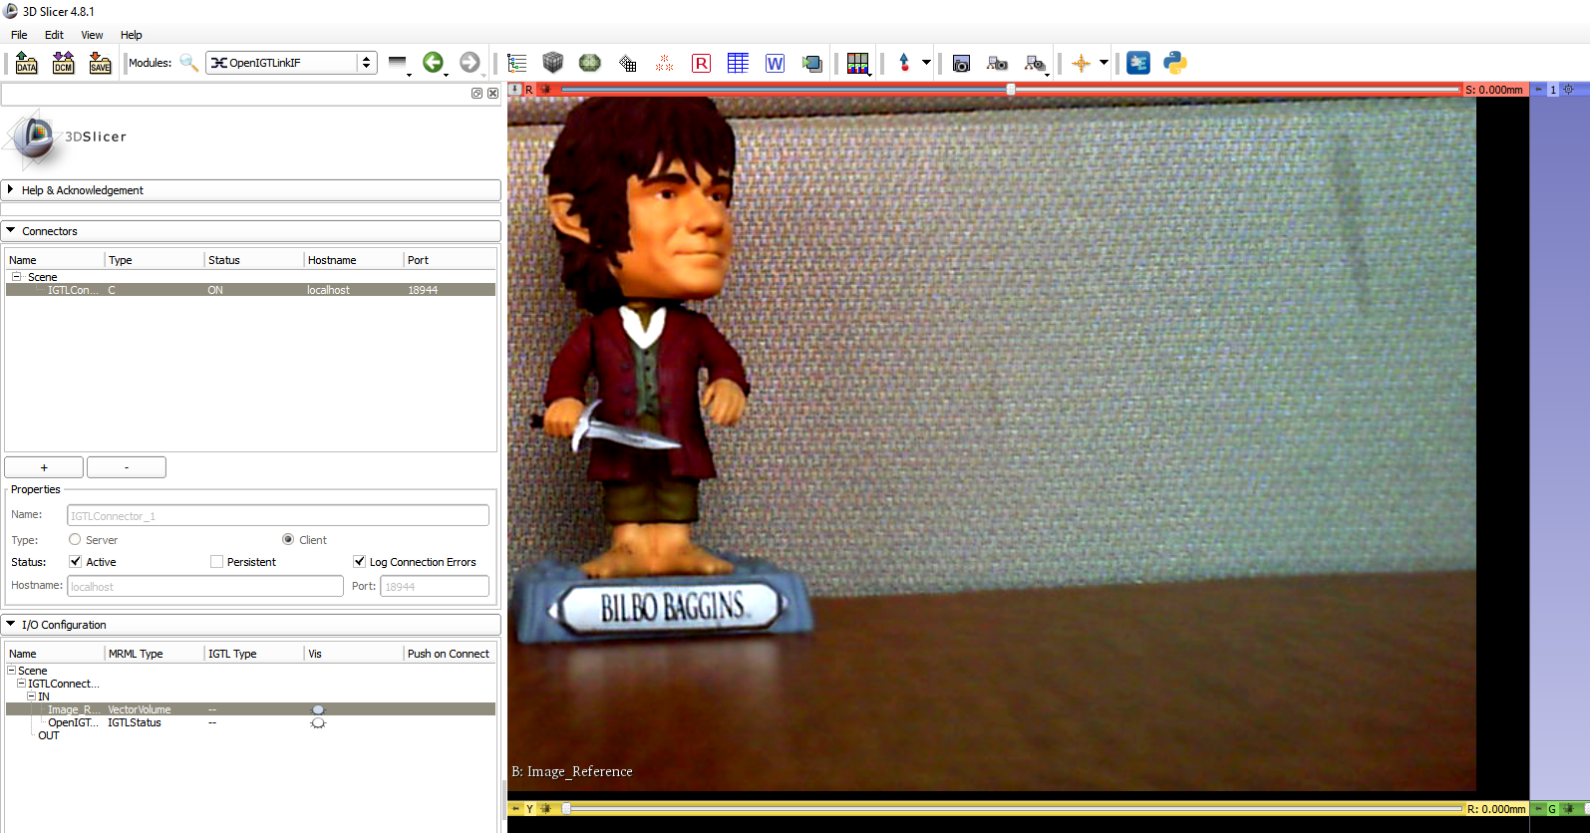
View Sent Images
Re-center
See

Slide 42
Crop Image
<Device
Id="VideoDevice"
Type="MmfVideo"
FrameSize=“1280 720"
VideoFormat="YUY2"
CaptureDeviceId="0" >
<DataSources>
<DataSource Type="Video" Id="Video" PortUsImageOrientation="UN“ ImageType="RGB_COLOR" ClipRectangleOrigin="300 300" ClipRectangleSize=“400 400" />
</DataSources>
<OutputChannels>
<OutputChannel Id="VideoStream" VideoDataSourceId="Video" />
</OutputChannels>
</Device>
Add ClipRectangleOrigin="300 300" ClipRectangleSize=“400 400"
1,2

Slide 43
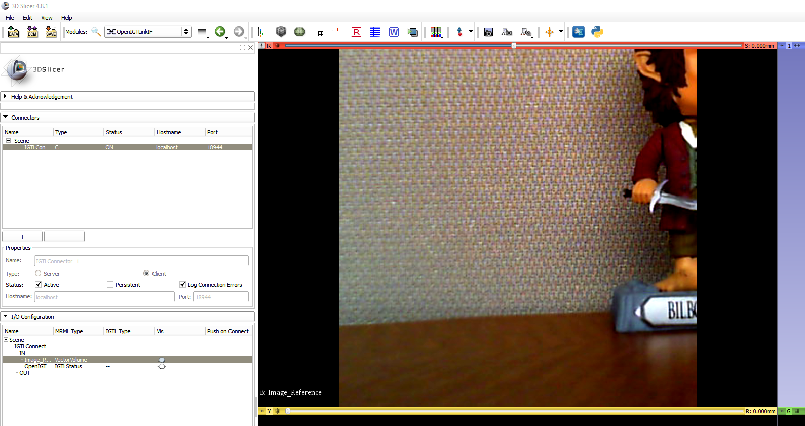
View Sent Images
Re-center
See

Slide 44
PLUS Configuration File Tutorial: Optical Marker Tracking

Slide 45
Start PLUS Server Launcher

Slide 46
Select Configuration File Directory
1
2
Directory where you installed PLUS (C:/Users/<YourUserName>/PlusApp-…-Win32/config)
Choose “config” subdirectory
3

Slide 47
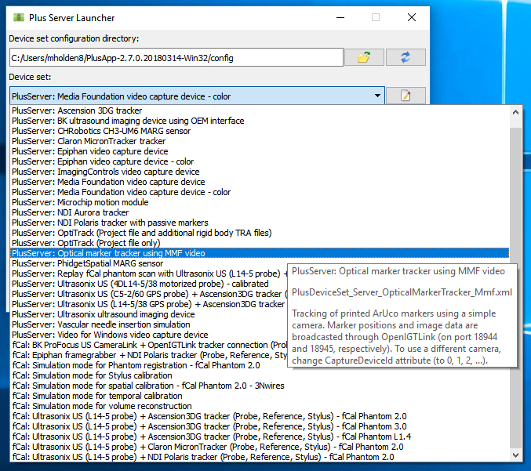
Choose Configuration for Optical Tracking
1
2

Slide 48
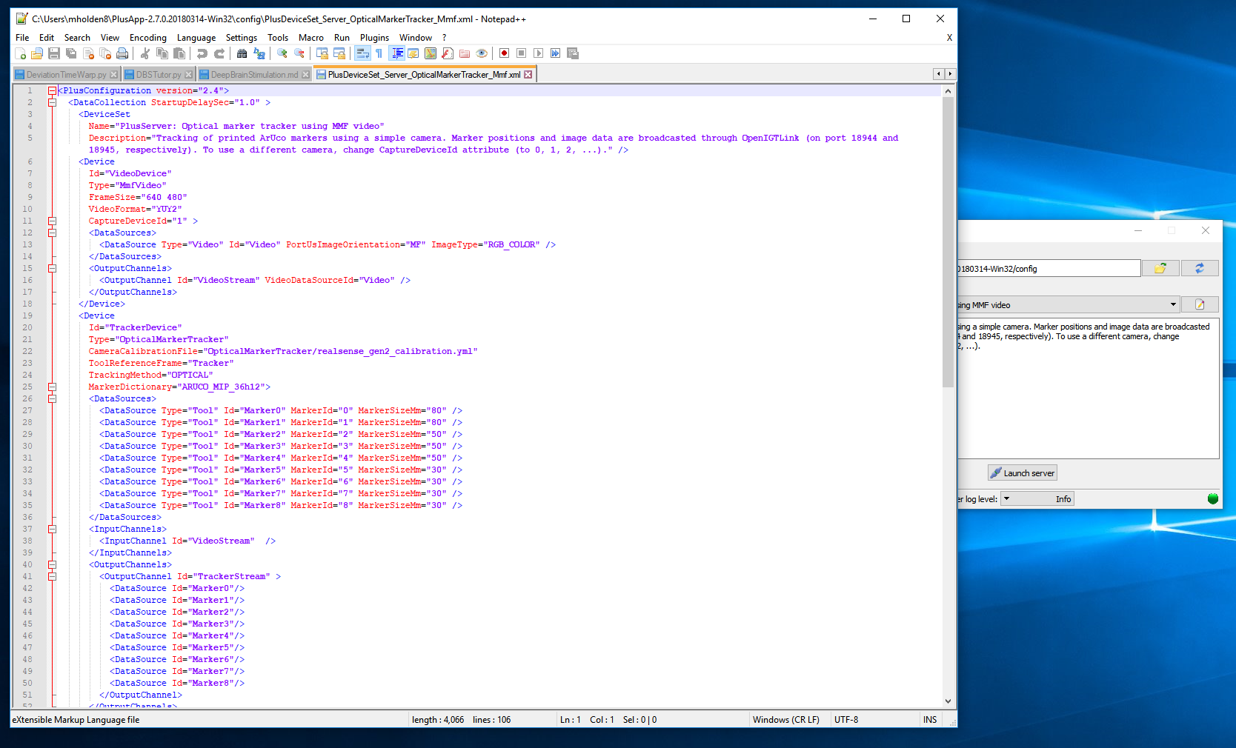
Edit Configuration Files
1
See

Slide 49
Orienting Image Properly
<Device
Id="VideoDevice"
Type="MmfVideo"
FrameSize="640 480"
VideoFormat="YUY2"
CaptureDeviceId="0" >
<DataSources>
<DataSource Type="Video" Id="Video" PortUsImageOrientation="UN" ImageType="RGB_COLOR" />
</DataSources>
<OutputChannels>
<OutputChannel Id="VideoStream" VideoDataSourceId="Video" />
</OutputChannels>
</Device>
Change to “UN”
(if this does not work, try “MN”)
Change to “0”

Slide 50
Remove Unused Markers
<Device
Id="TrackerDevice"
Type="OpticalMarkerTracker"
CameraCalibrationFile="OpticalMarkerTracker/realsense_gen2_calibration.yml"
ToolReferenceFrame="Tracker"
TrackingMethod="OPTICAL"
MarkerDictionary="ARUCO_MIP_36h12">
<DataSources>
<DataSource Type="Tool" Id="Marker0" MarkerId="0" MarkerSizeMm="80" />
<DataSource Type="Tool" Id="Marker1" MarkerId="1" MarkerSizeMm="80" />
</DataSources>
<InputChannels>
<InputChannel Id="VideoStream" />
</InputChannels>
<OutputChannels>
<OutputChannel Id="TrackerStream" >
<DataSource Id="Marker0"/>
<DataSource Id="Marker1"/>
</OutputChannel>
</OutputChannels>
</Device>
Remove here
We will only use two markers for our setup.
We use markers 0 and 1.
Remove here

Slide 51
Change Marker Sizes
<Device
Id="TrackerDevice"
Type="OpticalMarkerTracker"
CameraCalibrationFile="OpticalMarkerTracker/realsense_gen2_calibration.yml"
ToolReferenceFrame="Tracker"
TrackingMethod="OPTICAL"
MarkerDictionary="ARUCO_MIP_36h12">
<DataSources>
<DataSource Type="Tool" Id="Marker0" MarkerId="0" MarkerSizeMm=“40" />
<DataSource Type="Tool" Id="Marker1" MarkerId="1" MarkerSizeMm=“40" />
</DataSources>
<InputChannels>
<InputChannel Id="VideoStream" />
</InputChannels>
<OutputChannels>
<OutputChannel Id="TrackerStream" >
<DataSource Id="Marker0"/>
<DataSource Id="Marker1"/>
</OutputChannel>
</OutputChannels>
</Device>
Change to “40” here.
Our printed markers are 40mm x 40 mm.

Slide 52
Change Sent Transforms
<PlusOpenIGTLinkServer
MaxNumberOfIgtlMessagesToSend="1"
MaxTimeSpentWithProcessingMs="50"
ListeningPort="18944"
SendValidTransformsOnly="true"
OutputChannelId="TrackerStream" >
<DefaultClientInfo>
<MessageTypes>
<Message Type="TRANSFORM" />
</MessageTypes>
<TransformNames>
<Transform Name="Marker1ToMarker0" />
<Transform Name="Marker0ToTracker" />
<Transform Name="Marker1ToTracker" />
</TransformNames>
</DefaultClientInfo>
</PlusOpenIGTLinkServer>
Add here
Add the transform “Marker1ToMarker0”.
Remove here
We only have transforms from markers 0 and 1.

Slide 53
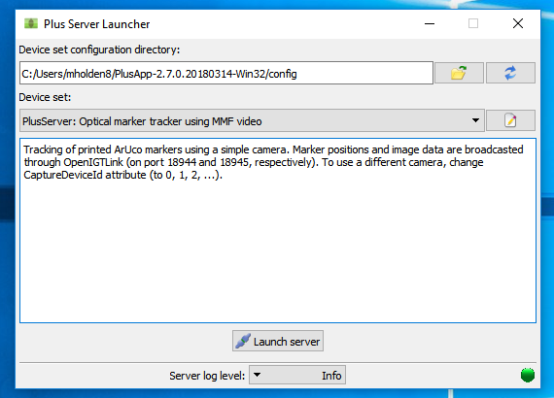
Launch Server
1
May take a few seconds…

Slide 54
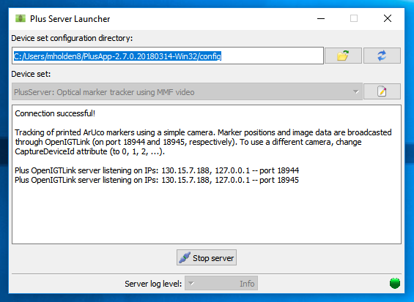
Check Connection
See

Slide 55
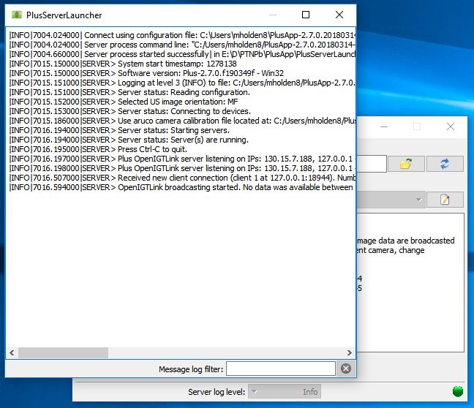
Check Message Log
1

Slide 56
Connect from Slicer
1
2

Slide 57
Connect from Slicer
1
2
See
Should populate with
Scene > IGTLConnector > IN > Marker0ToTracker, Marker1ToTracker, Marker0ToMarker1

Slide 58
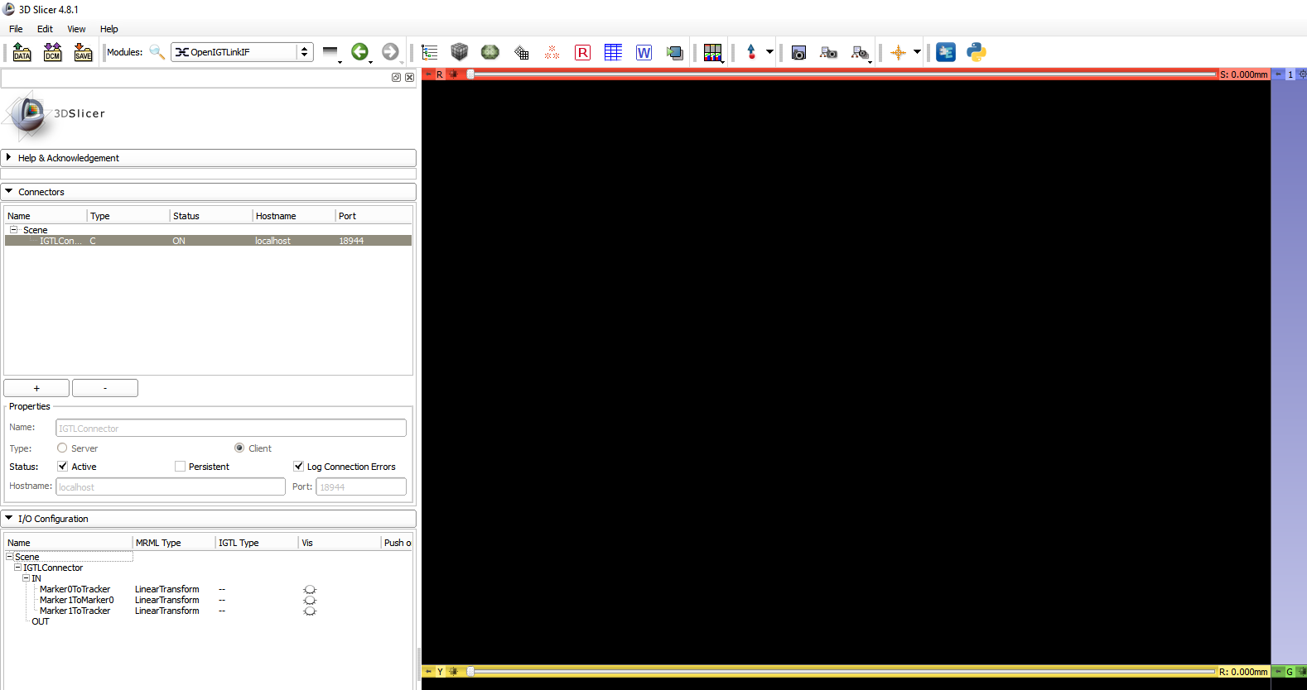
Connect from Slicer
1
3
2
Change to 18945.
See
Should populate with
Scene > IGTLConnector_1 > IN > Image_Image

Slide 59
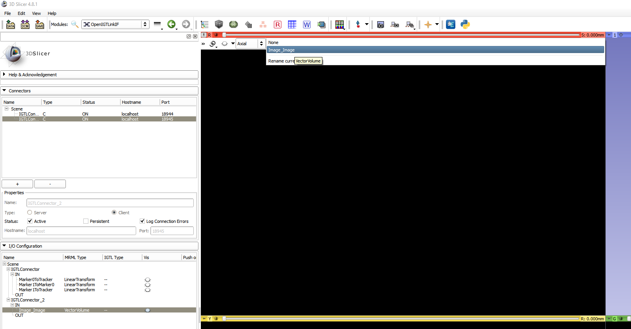
View Sent Images
1
2

Slide 60
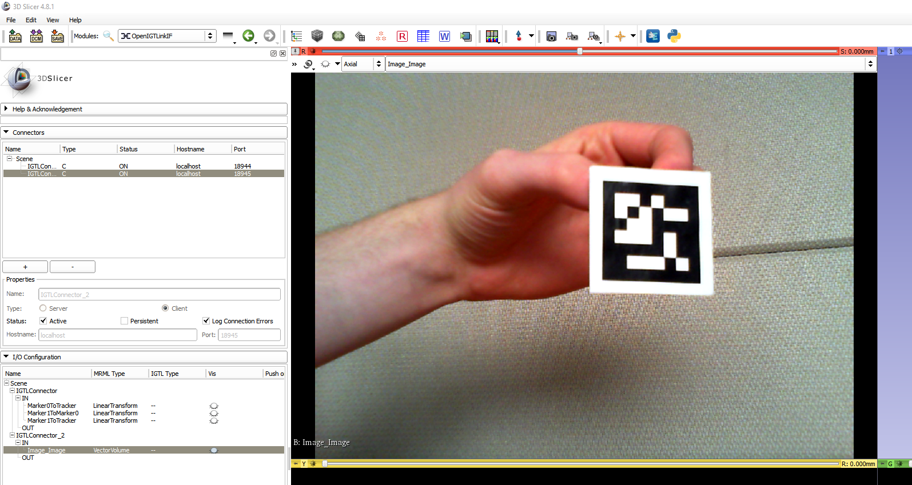
View Sent Images
1
See

Slide 61
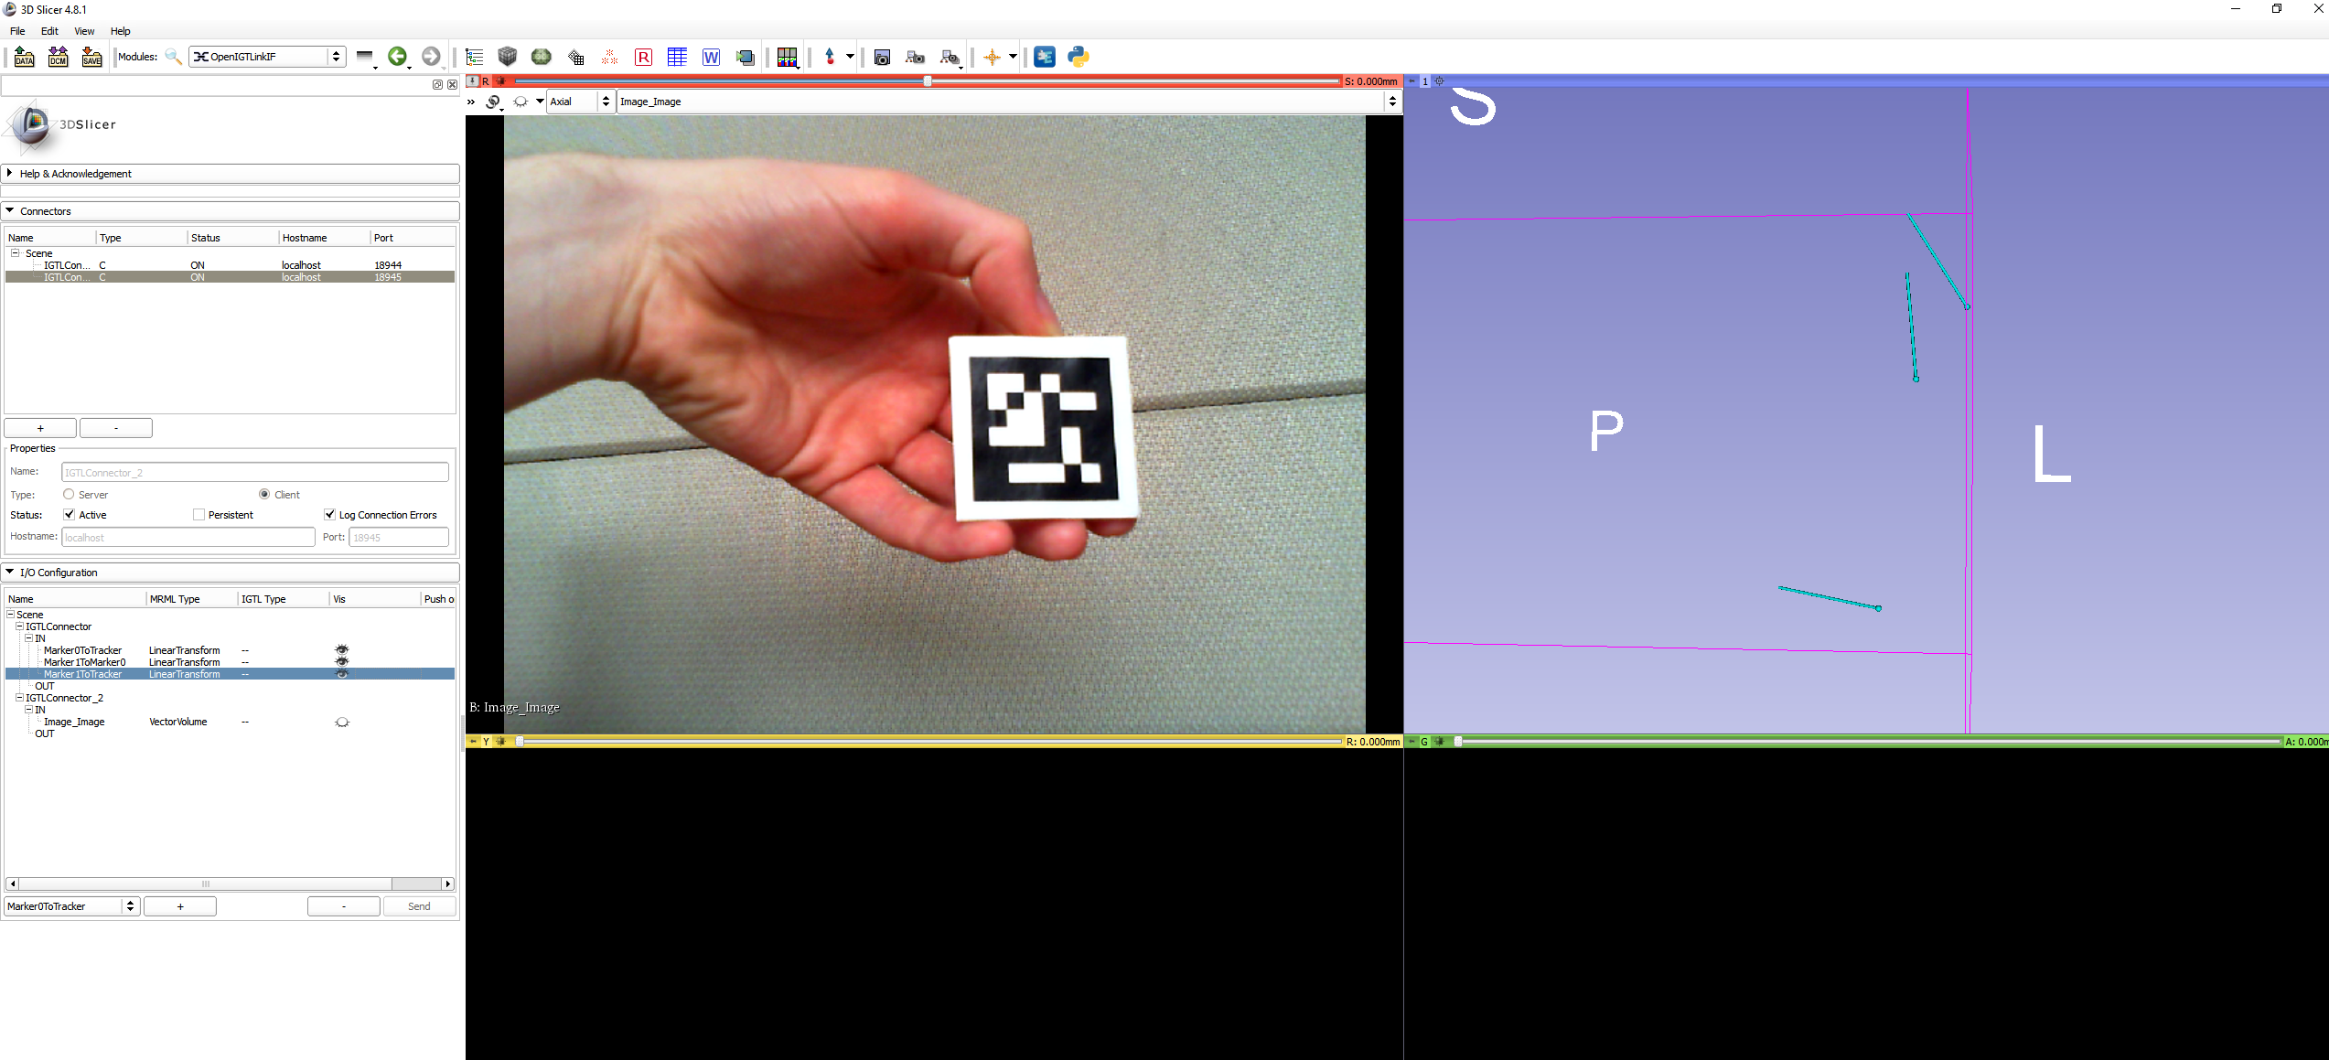
View Sent Transforms
4
See
1
2
3

Slide 62


Acknowledgements
PLUS (www.plustoolkit.org)
Andras Lasso, Tamas Heffter, Adam Rankin, Csaba Pinter, Tamas Ungi, and Gabor Fichtinger, "PLUS: Open-source toolkit for ultrasound-guided intervention systems", IEEE Trans Biomed Eng. 2014 Oct;61(10):2527-37.
Matthew Holden (72mh@queensu.ca)
Kyle Sunderland (1krs1@queensu.ca)

